Slide 1




Liquid Propellant Rocket Engine Combustion Chambers
Consist of devices to inject propellant (fuel and oxidizer).
A space where fuel and oxidizer can vaporize, mix, and react to equilibrium conditions.
An ignition system.
9:35 AM

Slide 2
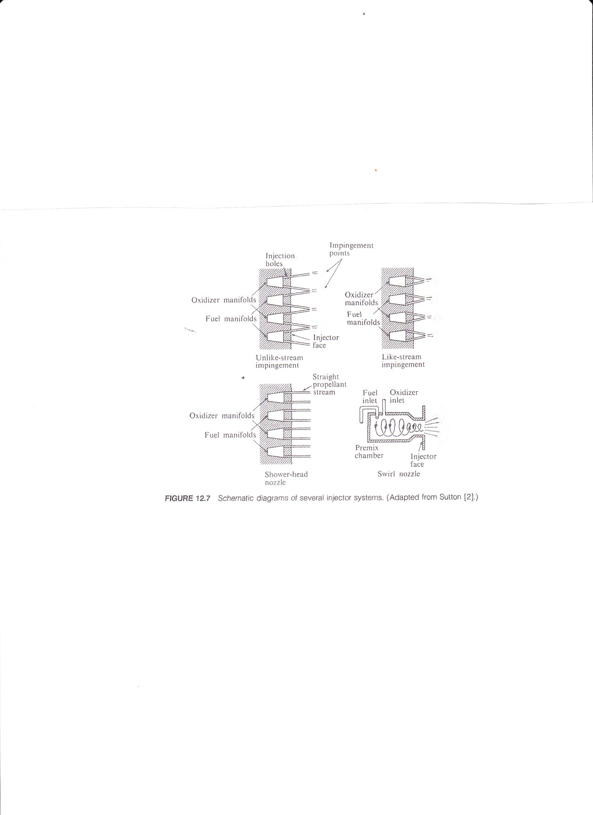

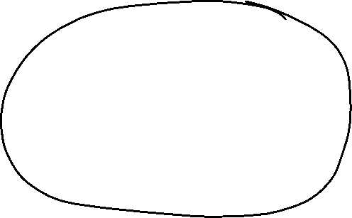
Injectors
The injector atomizes the propellant to facilitate mixing of fuel with oxidizer to establish stable combustion. It is mounted at the head end of the thrust chamber.
Some typical injector elements are unlike-doublet, like-doublet, showerhead and swirl.
Unlike-doublets are used with hypergolic propellants.
Swirl-type has been successful with monopropellants.

Slide 3
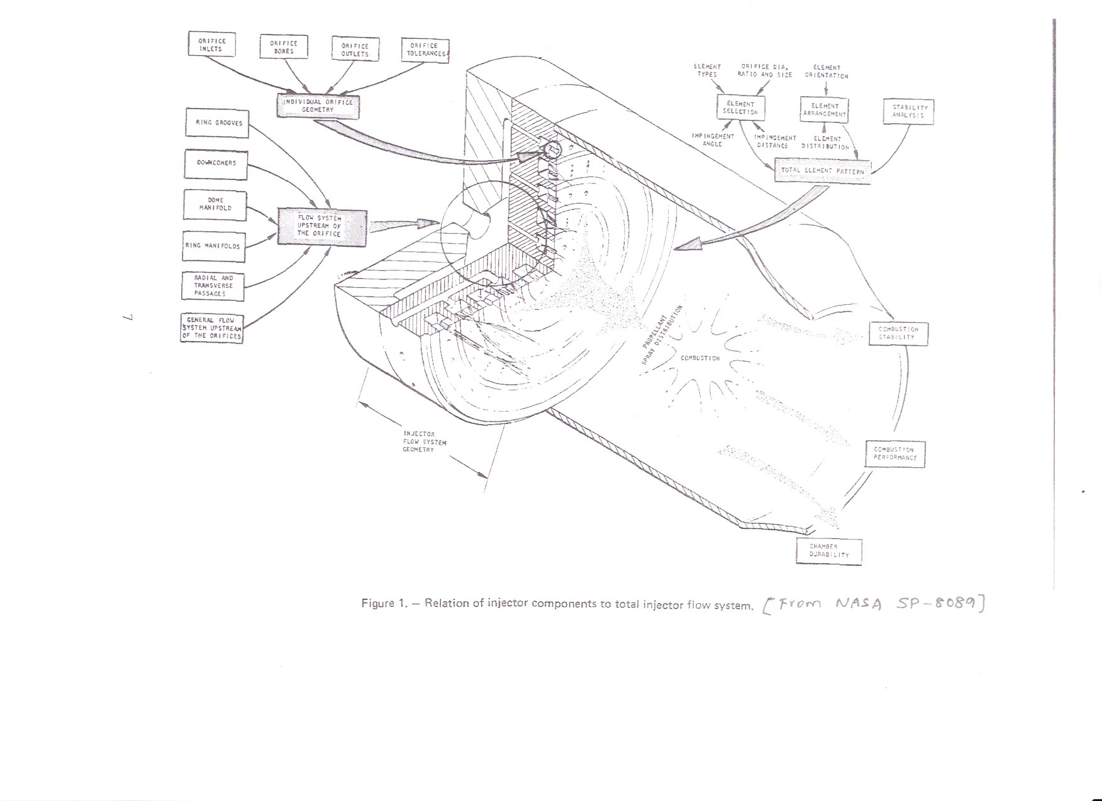
Injectors
Combustion instability is common in high energy systems.
In “chugging,” the pressure variation in the combustion chamber couples with the fuel and oxidizer feed system. This is eliminated by increasing the pressure drop across the injector. This requires higher pump capability and results in high injection velocity.
“Screaming” is associated with the flow region close to the injector head, and proper development of the flow geometry here is important.

